Slide 1
Unit I - INTRODUCTION TO FORECASTING

Slide 2
Time Series Analysis Types
Models of time series analysis include:
Classification: Identifies and assigns categories to the data.
Curve fitting: Plots the data along a curve to study the relationships of variables within the data.
Descriptive analysis: Identifies patterns in time series data, like trends, cycles, or seasonal variation.
Explanative analysis: Attempts to understand the data and the relationships within it, as well as cause and effect.
Exploratory analysis: Highlights the main characteristics of the time series data, usually in a visual format.
Forecasting: Predicts future data. This type is based on historical trends. It uses the historical data as a model for future data, predicting scenarios that could happen along future plot points.
Intervention analysis: Studies how an event can change the data.
Segmentation: Splits the data into segments to show the underlying properties of the source information.

Slide 3
Time series analysis examples
Weather data
Rainfall measurements
Temperature readings
Heart rate monitoring (EKG)
Brain monitoring (EEG)
Quarterly sales
Stock prices
Automated stock trading
Industry forecasts
Interest rates

Slide 4
Data classification
Further, time series data can be classified into two main categories:
Stock time series data means measuring attributes at a certain point in time, like a static snapshot of the information as it was.
Flow time series data means measuring the activity of the attributes over a certain period, which is generally part of the total whole and makes up a portion of the results.
Data variations
In time series data, variations can occur sporadically throughout the data:
Functional analysis can pick out the patterns and relationships within the data to identify notable events.
Trend analysis means determining consistent movement in a certain direction. There are two types of trends: deterministic, where we can find the underlying cause, and stochastic, which is random and unexplainable.
Seasonal variation describes events that occur at specific and regular intervals during the course of a year. Serial dependence occurs when data points close together in time tend to be related.
Notes:
https://opentimeseries.com/

Slide 5
Important Considerations for Time Series Analysis
While time series data is data collected over time, there are different types of data that describe how and when that time data was recorded. For example:
Time series data is data that is recorded over consistent intervals of time.
Cross-sectional data consists of several variables recorded at the same time.
Pooled data is a combination of both time series data and cross-sectional data.

Slide 6
Statistics Background For Forecasting
Forecasts are based on data or observations on the variable of interest.
These data are usually in the form of a time series.
Suppose –
T periods of data available, with period T being the most recent.
We will let the observation on this variable at time period t be denoted by yt, t = 1,2,…, T. This variable can represent a cumulative quantity.
https://unit8co.github.io/darts/generated_api/darts.utils.statistics.html
https://opentimeseries.com/
Notes:
https://otexts.com/
https://unit8co.github.io/darts/generated_api/darts.utils.statistics.html

Slide 7
distinguish between a forecast or predicted value of – [ (yt). Fitted value ]
say, t − 𝜏, and a fitted value of yt that has resulted from estimating the parameters in a time series model to historical data.
Note that (𝜏) - is the forecast lead time
The forecast made at time period t − 𝜏 is denoted by ̂yt(t − 𝜏).
There is a lot of interest in the lead − 1 forecast, which is the forecast of the observation in period t, yt, made one period prior, ̂yt(t − 1). We will denote the fitted value of yt by ̂yt.

Slide 8
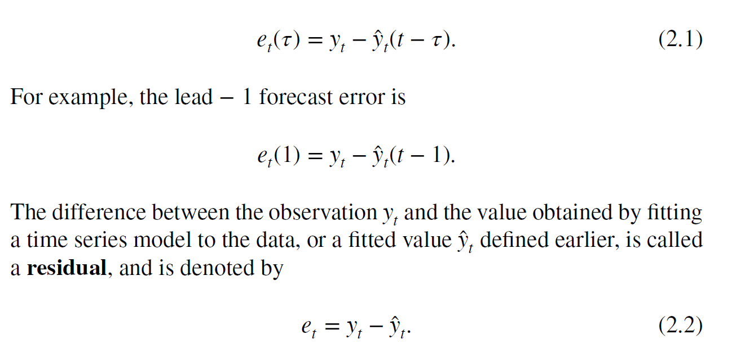
We will also be interested in analyzing forecast errors.
The forecast error that results from a forecast of yt that was made at time period t − 𝜏 is the lead − 𝝉 forecast error
The reason for this careful distinction between forecast errors and residuals is that models usually fit historical data better than they forecast
Notes:
Generally, we will need to distinguish between a forecast or predicted
value of yt that was made at some previous time period, say, t − 𝜏, and a
fitted value of yt that has resulted from estimating the parameters in a time
series model to historical data. Note that 𝜏 is the forecast lead time. The
forecast made at time period t − 𝜏 is denoted by ̂yt(t − 𝜏). There is a lot of
interest in the lead − 1 forecast, which is the forecast of the observation
in period t, yt, made one period prior, ̂yt(t − 1). We will denote the fitted
value of yt by ̂yt.
We will also be interested in analyzing forecast errors. The forecast
error that results from a forecast of yt that was made at time period t − 𝜏 is
the lead − 𝝉 forecast error
et(𝜏) = yt − ̂yt(t − 𝜏). (2.1)
For example, the lead − 1 forecast error is
et(1) = yt − ̂yt(t − 1).
The difference between the observation yt and the value obtained by fitting
a time series model to the data, or a fitted value ̂yt defined earlier, is called
a residual, and is denoted by
et = yt − ̂yt. (2.2)
The reason for this careful distinction between forecast errors and residuals
is that models usually fit historical data better than they forecast. That is,
the residuals from a model-fitting process will almost always be smaller
than the forecast errors that are experienced when that model is used to
forecast future observations.

Slide 9
Time Series Statistics
https://unit8co.github.io/darts/generated_api/darts.utils.statistics.html
https://www.geeksforgeeks.org/r-statistics/

Slide 10
Graphical Displays
Time Series Plots-
Developing a forecasting model should always begin with graphical display and analysis of the available data.
The basic graphical display for time series data is the time series plot
Notes:
https://www.geeksforgeeks.org/8-types-of-plots-for-time-series-analysis-using-python/

Slide 11
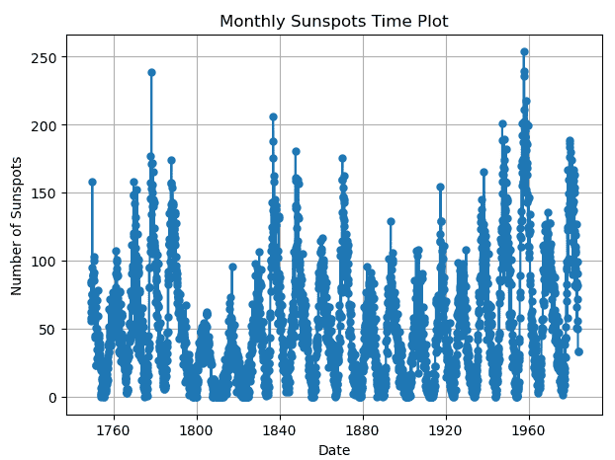
Types of Plots for Time Series Analysis using Python
1. Time Plot
One of the most basic representations of time series data is the time plot, sometimes called a time series plot. The x-axis is time, and the y-axis is the relevant variable, and it shows data points in chronological order.
Notes:
https://www.geeksforgeeks.org/8-types-of-plots-for-time-series-analysis-using-python/

Slide 12
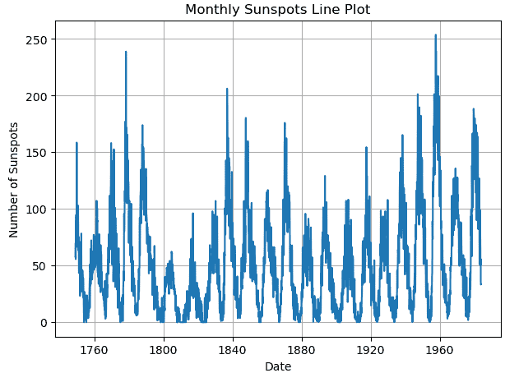
2. Line Plot
A simple visualization that links data points with straight lines is known as a line plot.

Slide 13
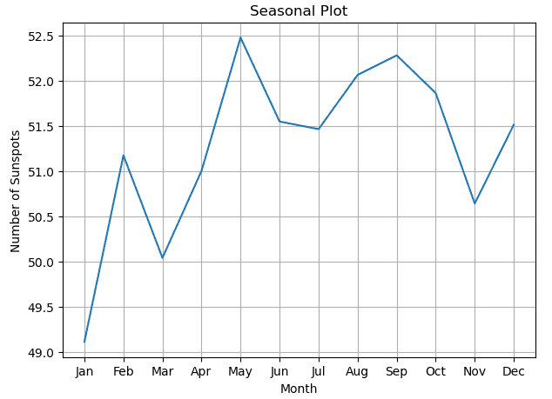
3. Seasonal Plot
The seasonal plot breaks down time series data into seasonal components to illustrate patterns that reoccur over predetermined time intervals, such as annual or monthly cycles. It enables us to recognize recurring trends in sunspot activity, such as variations in activity throughout the year.

Slide 14
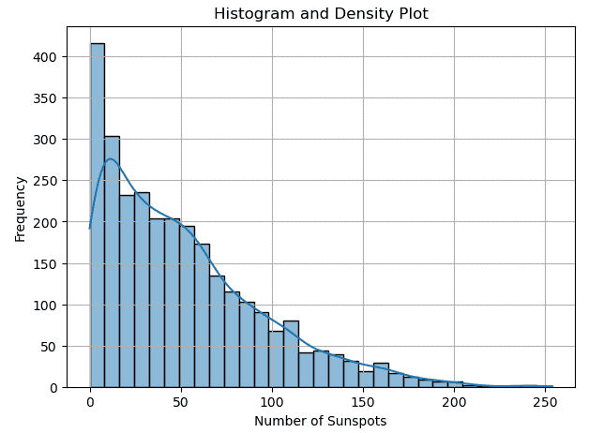
4. Histogram and Density Plot
A density plot is defined as a graphical representation which is used to visualize the distribution of data and estimate the probability density function (PDF) of a continuous random variable. It is basically a smoothed version of a histogram, providing a continuous curve that represents the underlying data distribution.

Slide 15
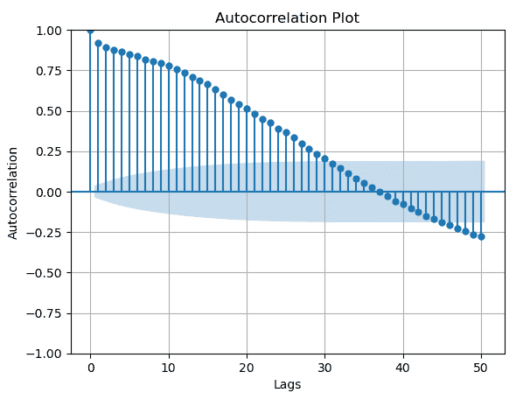
5. Autocorrelation Plot
Autocorrelation plot, also known as a correlogram is defined as a time series analysis tool used to display the autocorrelation of a time series with itself at various lags.

Slide 16
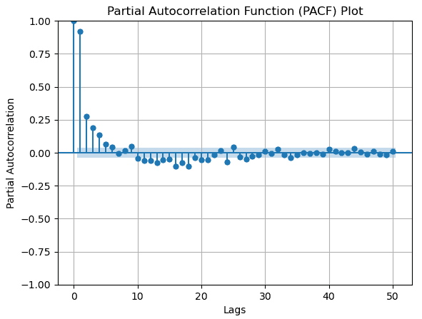
6. Partial Autocorrelation Function (PACF) Plot
The Partial Autocorrelation Function (PACF) plot is a graphical tool used in time series analysis to determine the autoregressive (AR) order of a time series.

Slide 17
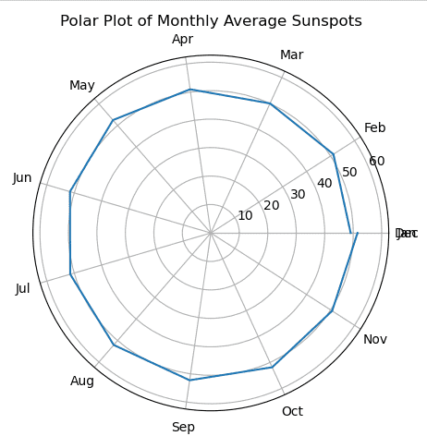
7. Polar Plot
A polar plot is a data visualization plot in which the data points are arranged in a circular pattern.

Slide 18
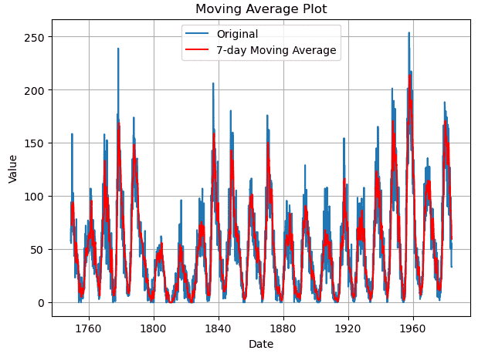
8. Moving Average Plot
In time series analysis, a Moving average plot is a popular data visualization approach for spotting trends and patterns in the data.

Slide 19
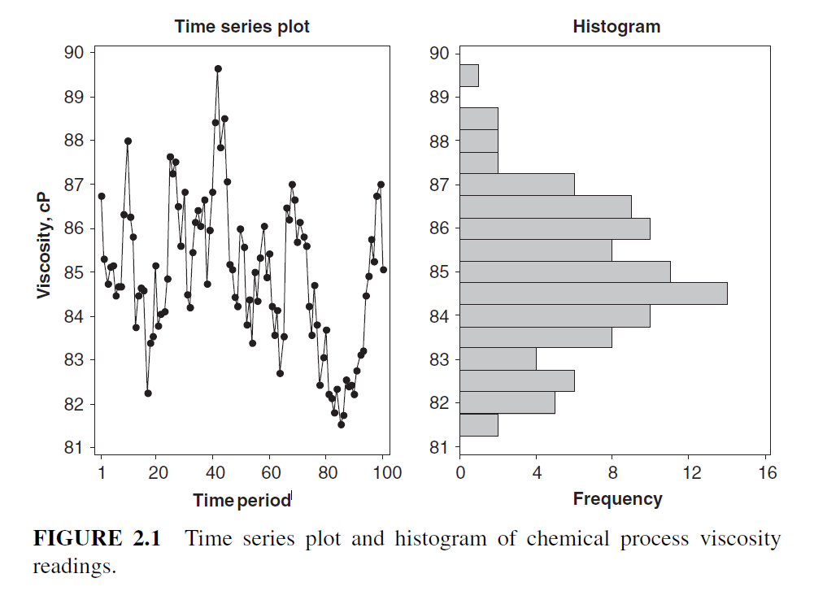
Example 2.1 Figures 2.1 and 2.2 show time series plots for viscosity readings and beverage production shipments

Slide 20
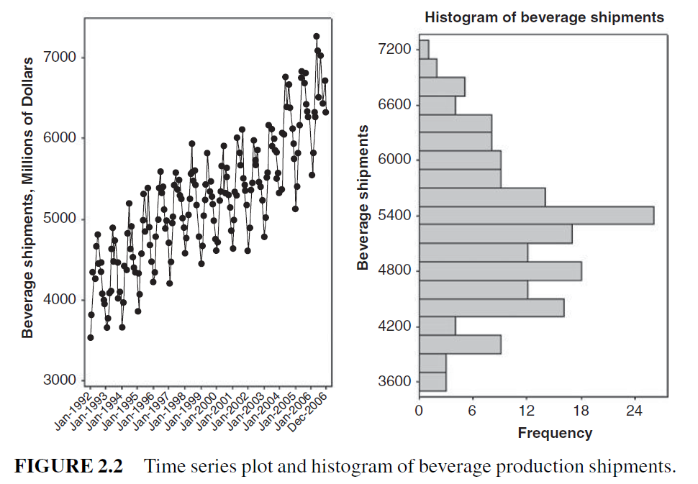

Slide 21
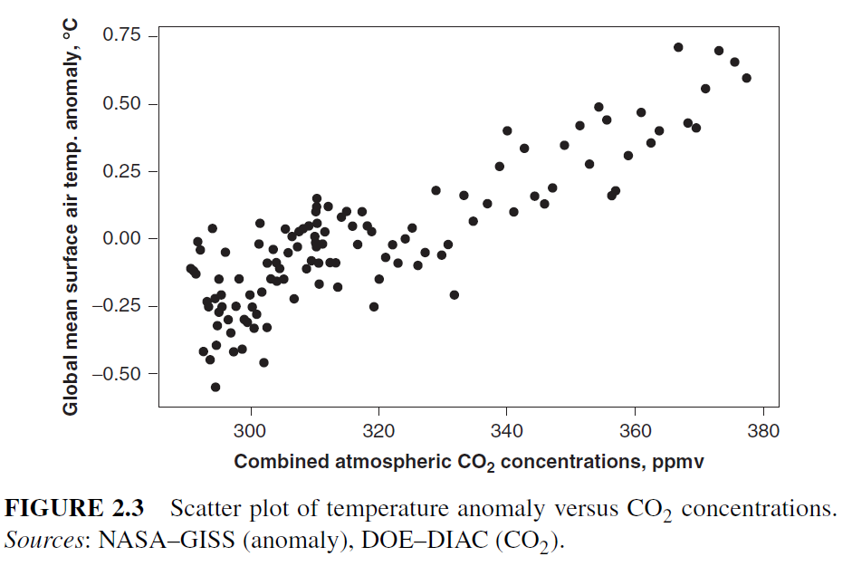
Figure 2.3 is a scatter plot of the annual global mean surface air temperature

Slide 22
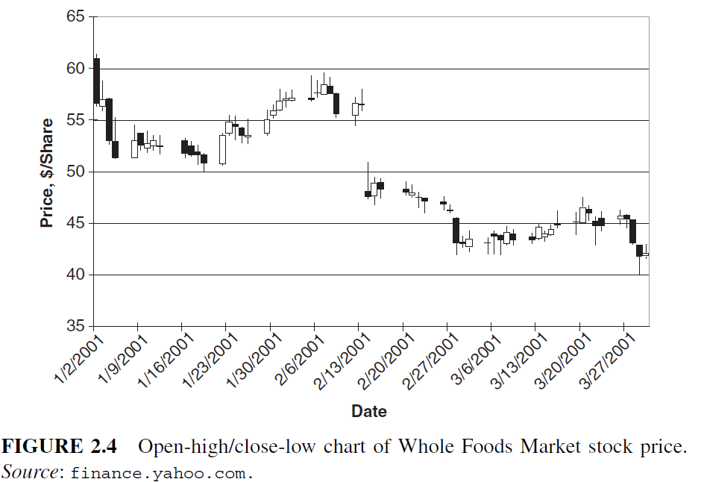
There are many variations of the time series plot and other graphical displays that can be constructed to show specific features of a time series
Figure 2.4 displays daily price information for Whole Foods Market stock during the first quarter of 2001

Slide 23
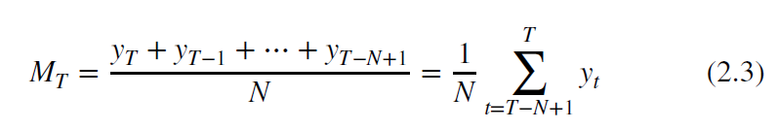
Plotting Smoothed Data
There are several types of data smoothers that can be employed. One of the simplest and most widely used is the ordinary or simple moving average.
A simple moving average of span N assigns weights 1/N to the most recent N observations yT , yT−1,…, yT−N+1, and weight zero to all other observations. If we let MT be the moving average, then the N-span moving average at time period T is
(yt). Fitted value

Slide 24
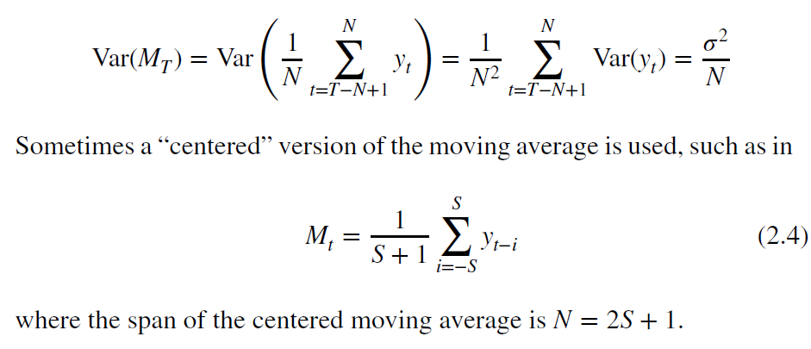
The moving average has less variability than the original observations; in fact, if the variance of an individual observation yt is 𝜎2, then assuming that the observations are uncorrelated the variance of the moving average is
Notes:
https://www.geeksforgeeks.org/how-to-calculate-moving-average-in-a-pandas-dataframe/

Slide 25
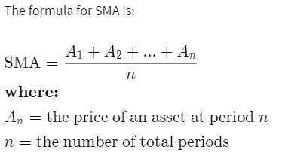
Simple moving average (SMA)
Plotting Smoothed Data
A simple moving average (SMA) is an arithmetic moving average calculated by adding recent prices and then dividing that figure by the number of time periods in the calculation average.
There are other types of moving averages, including the exponential moving average (EMA) and the weighted moving average (WMA).

Slide 26
For example, this is how you would calculate the simple moving average of a security with the following closing prices over a 15-day period.
Week One (5 days): 20, 22, 24, 25, 23
Week Two (5 days): 26, 28, 26, 29, 27
Week Three (5 days): 28, 30, 27, 29, 28
20 + 22 + 24 + 25 + 23 + 26 + 28 + 26 + 29 + 27 + 28 + 30 + 27 + 29 + 28 = 392
392 / 15 = 26.13
The 15-day simple moving average for this security would be $26.13.

Slide 27
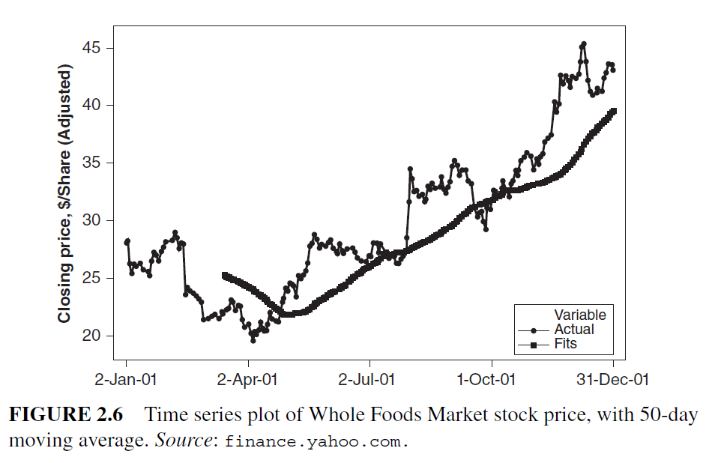
Example moving average

Slide 28
The simple moving average is a linear data smoother, or a linear filter, because it replaces each observation yt with a linear combination of the other data points that are near to it in time.
The weights in the linear combination are equal, so the linear combination here is an average. Of course unequal weights could be used.
For example, the Hanning filter is a weighted, centered moving average MH
t = 0.25yt+1 + 0.5yt + 0.25yt−1
(yt). Fitted value

Slide 29
disadvantage of a linear filter
An obvious disadvantage of a linear filter such as a moving average is that an unusual or erroneous data point or an outlier will dominate the moving averages that contain that observation
, , 13, 13, 14, 16, 17, 17, 18, 18, 19, 19, 19, 21, 21, ,

Slide 30
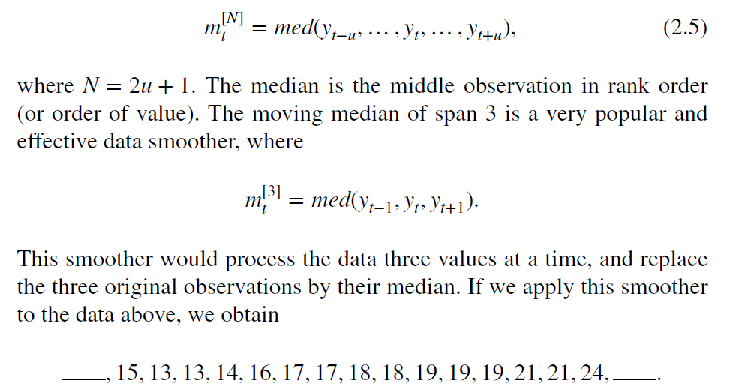
Odd-span moving medians (also called running medians) are an alternative to moving averages that are effective data smoothers when the time series may be contaminated with unusual values or outliers. The moving median of span N is defined as

Slide 31
NUMERICAL DESCRIPTION OF TIME SERIES DATA
Stationary Time Series
A very important type of time series is a stationary time series. A time series is said to be strictly stationary if its properties are not affected by a change in the time origin.
That is, if the joint probability distribution of the observations yt, yt+1,…, yt+n is exactly the same as the joint probability distribution of the observations yt+k, yt+k+1,…, yt+k+n then the time series is strictly stationary.
When n = 0 the stationarity assumption means that the probability distribution of yt is the same for all time periods and can be written as f (y).

Slide 32
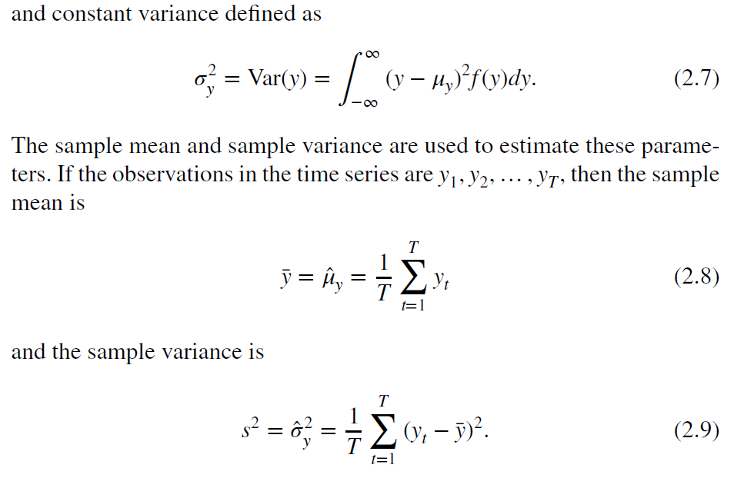
Stationary implies a type of statistical equilibrium or stability in the data.

Slide 33
Autocovariance and Autocorrelation Functions
If a time series is stationary this means that the joint probability distribution of any two observations, say, yt and yt+k, is the same for any two time periods t and t + k that are separated by the same interval k.
Useful information about this joint distribution, and hence about the nature of the time series, can be obtained by plotting a scatter diagram of all of the data pairs yt, yt+k that are separated by the same interval k.
The interval k is called the lag.

Slide 34
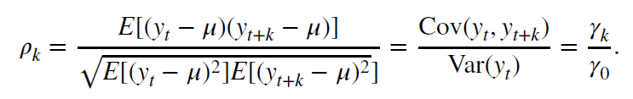
The covariance between yt and its value at another time period, say, yt+k is called the autocovariance at lag k, defined by
𝛾k = Cov(yt, yt+k) = E[(yt − 𝜇)(yt+k − 𝜇)].
The collection of the values of 𝛾k, k = 0, 1, 2,… is called the autocovariance function.
The autocorrelation coefficient at lag k for a stationary time series is
The collection of the values of 𝜌k, k = 0, 1, 2,…is called the autocorrelation function (ACF). Note that by definition 𝜌0 = 1

Slide 35
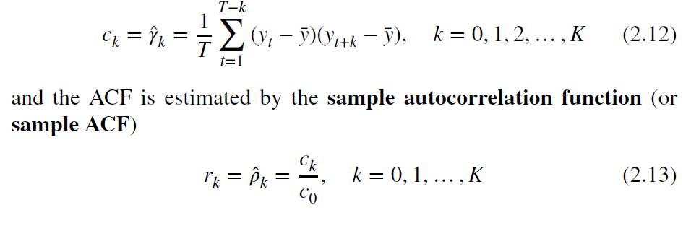
It is necessary to estimate the autocovariance and ACFs from a time series of finite length, say, y1, y2,…, yT. The usual estimate of the autocovariance function is

Slide 36
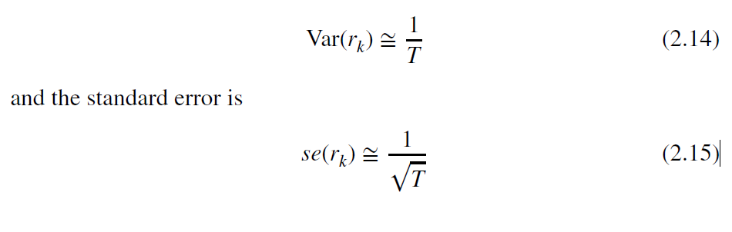
sample autocorrelation coefficient is

Slide 37
The Variogram
A variogram is a tool used in geostatistical modeling to analyze the spatial correlation of parameters by quantitatively assessing the semi variance over a predetermined lag distance.
Suppose that the time series observations are represented by yt. The variogram Gk measures variances of the differences between observations that are k lags apart, relative to the variance of the differences that are one time unit apart (or at lag 1). The variogram is defined mathematically as

Slide 38
